Slide 1
960:486
Linear Regression in R
Dhruv Shilotri
Date: 24th April, 2020.

Slide 2
Experimental process | Section of Paper
What did I do in a nutshell? | I used linear regression to find a model that finds correlation among different variable. This model can be used to predict a variable when only certain variables are known.
What is the problem? | We have to find a value for one variable and know the values of other variable that might be correlated with it.
How did I solve the problem? | We can find a model using linear regression that can be used to find the correlation among the variables and using it to predict a variable.
What did I find out? | We found that using linear regression, in our example our model is:
What does it mean? | It means that sales is significantly correlated to the variables, youtube and facebook but not with newspaper. To predict sales, we can use the regression model by inputting youtube and facebook.
Whose work did I refer to? | https://content.sakai.rutgers.edu/access/content/group/8e0a6401-8368-4be0-8dbe-bb6a59785c8a/Stat463.563.subset.smb.notes.p.3.to.96.pdf I used these notes from a regression analysis class taught by Prof. Ted Szatrowski.

Slide 3


What is Linear Regression?
The aim of linear regression is to model a continuous variable Y as a mathematical function of one or more X variable(s), so that we can use this regression model to predict the Y when only the X is known. This mathematical equation can be generalized as follows:
Y = β1 + β2X + ϵ
where, β1 is the intercept and β2 is the slope. Collectively, they are called regression coefficients. ϵ is the error term, the part of Y the regression model is unable to explain.

Slide 4
Procedure
We first start with finding descriptive statistics, histogram, scatterplots between all variables and correlation between them.
Next, we perform regression upon the given y variable and all x variables.
We then see if any x variable dropping affects the accuracy of the prediction of the y variable.
We drop the x variable with highest p-value and refit the model. If this model is better, we drop the next x variable with highest p-value and repeat the step.
If this refitted model is worst, we pick the previous model as our final model.

Slide 5
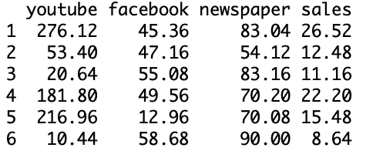
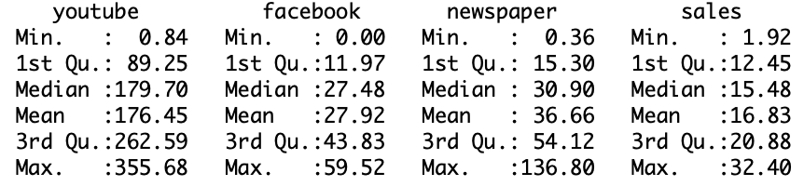
Example
We use an inbuilt dataset “marketing” in the library “datarium” to perform linear regression.
We take sales as the y variable, the variable to be predicted.
Youtube, facebook and newspaper become our x variables used to find a prediction for the y variable.
We next find the descriptive statistics for each variable using the command “summary(marketing)”.

Slide 6
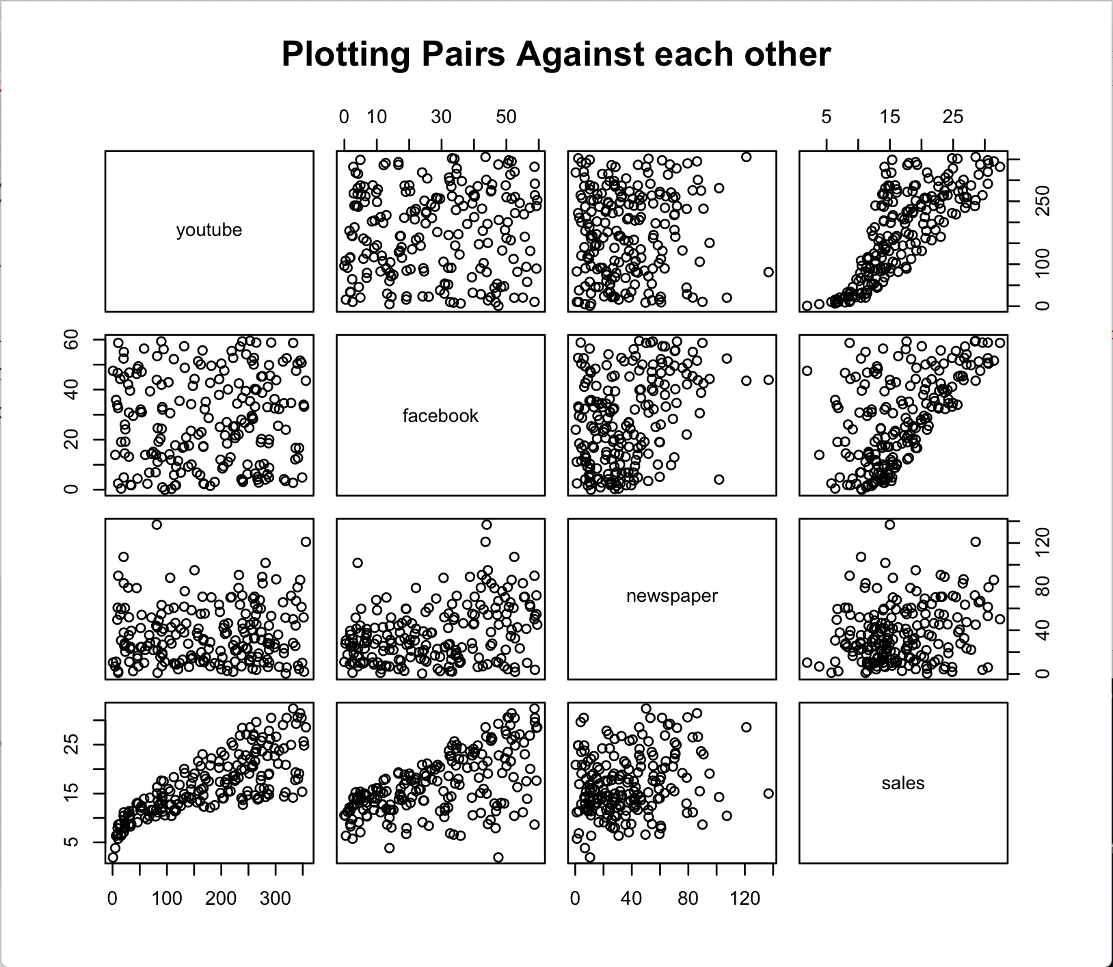

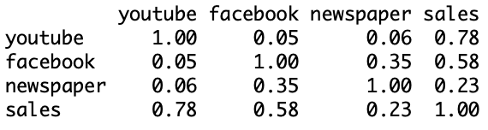
Example
We use “plot(marketing, main="Plotting Pairs Against each other")” command to find the plots between all variables.
To find the correlation matrix, we use cor function in “ggcorrplot” library.
From the correlation matrix, we find that sales and youtube are most correlated. This gives an indication that youtube will be most likely to be present in the prediction model.

Slide 7
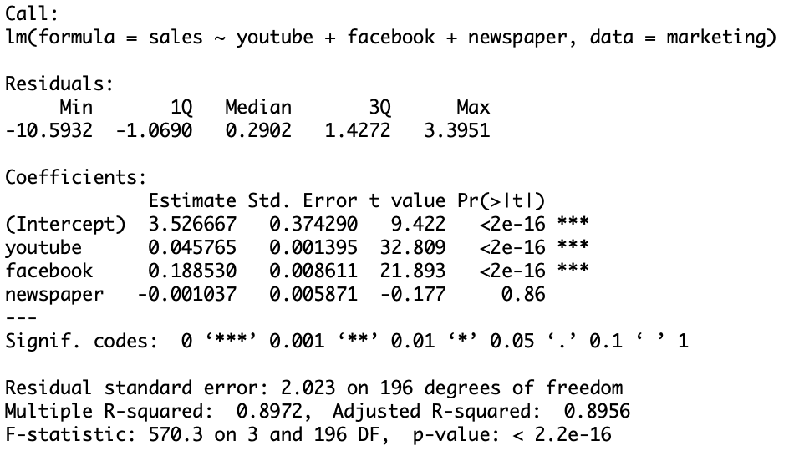
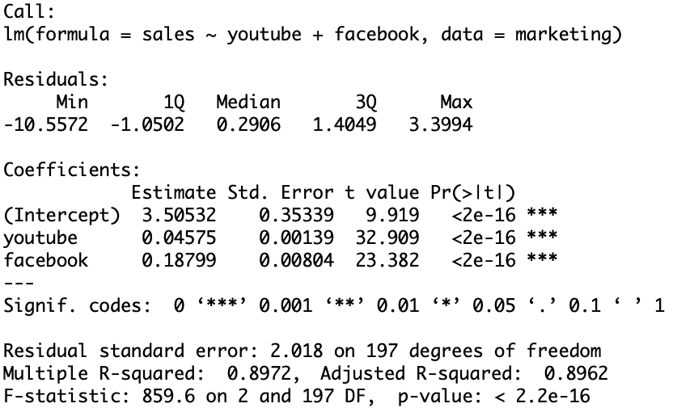
Example
We use lm function to find a regression model.
From the model, we find that p-value corresponding to “newspaper” is highest. So, we exclude the variable and re-fit the model.
We can tell that the two models have the same Multiple R-squared value and hence “newspaper” variable can be excluded from the model.

Slide 8
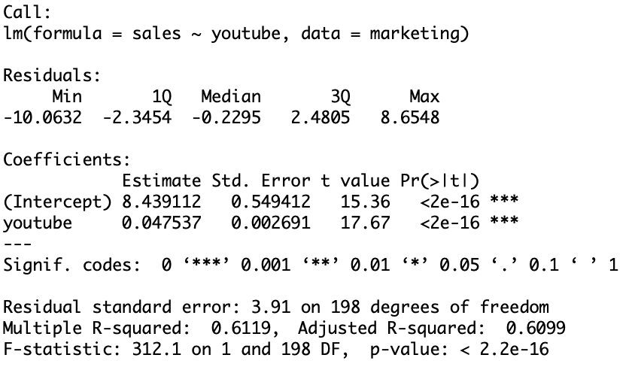
Example
We exclude facebook and find the corresponding model.
The previous model is a better predictor of sales compared to this model as the multiple R-squared value of this model is significantly lower.
Thus our final model is:

Slide 9
Thank You!

